Slide 1
The Brassica Information Portal
Resource for management of Brassica crops phenotyping data
Wiktor Jurkowski
AnneMARie eckes
Integrative Genomics Group
http://www.earlham.ac.uk/jurkowski-group
bip.earlham.ac.uk
Notes:
We are developing the Brassica Information Portal as a resource that collects, integrates and analyses phenotypic data from pre-breeding experiments on Brassica crop species.
The Portal will facilitate Brassica crop breeding with a data-driven approach: The data collected from phenotyping experiments are made accessible and available in a standardised manner. This data can be integrated with genotypic information. In the future, associative analysis tools will enable on the fly analysis between traits hosted in the Portal and external genotypic information.

Slide 2
Handling and analysis of phenotyping data
Need for storing brassica crop phenotypic data and integration for association studies
Problem
Diverse phenotypic data
Ambiguous trait definitions - how to replicate the experiment meaningfully?
Lack of flexible and user-friendly interface
Resource for management and analysis of phenotyping data
Notes:
very diverse measurments

Slide 3
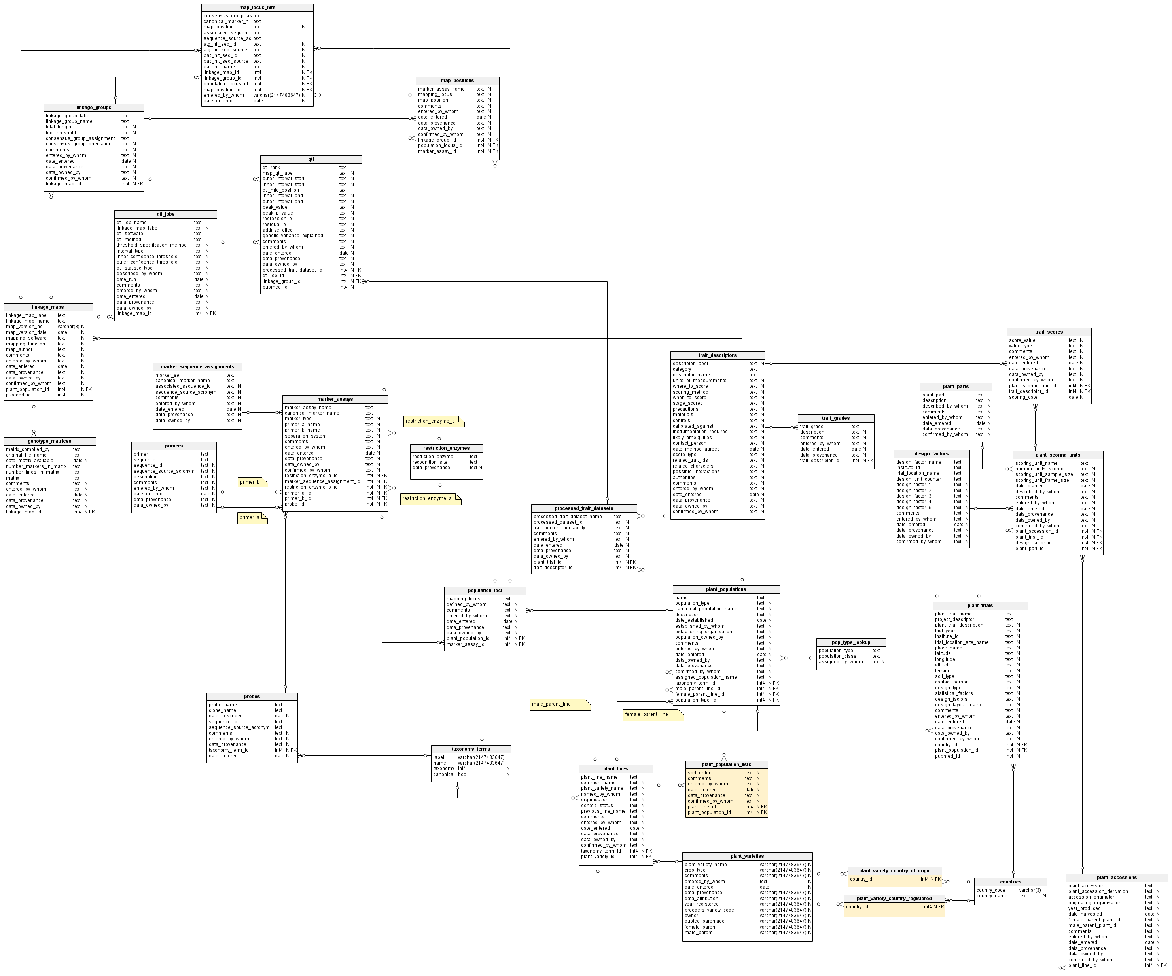
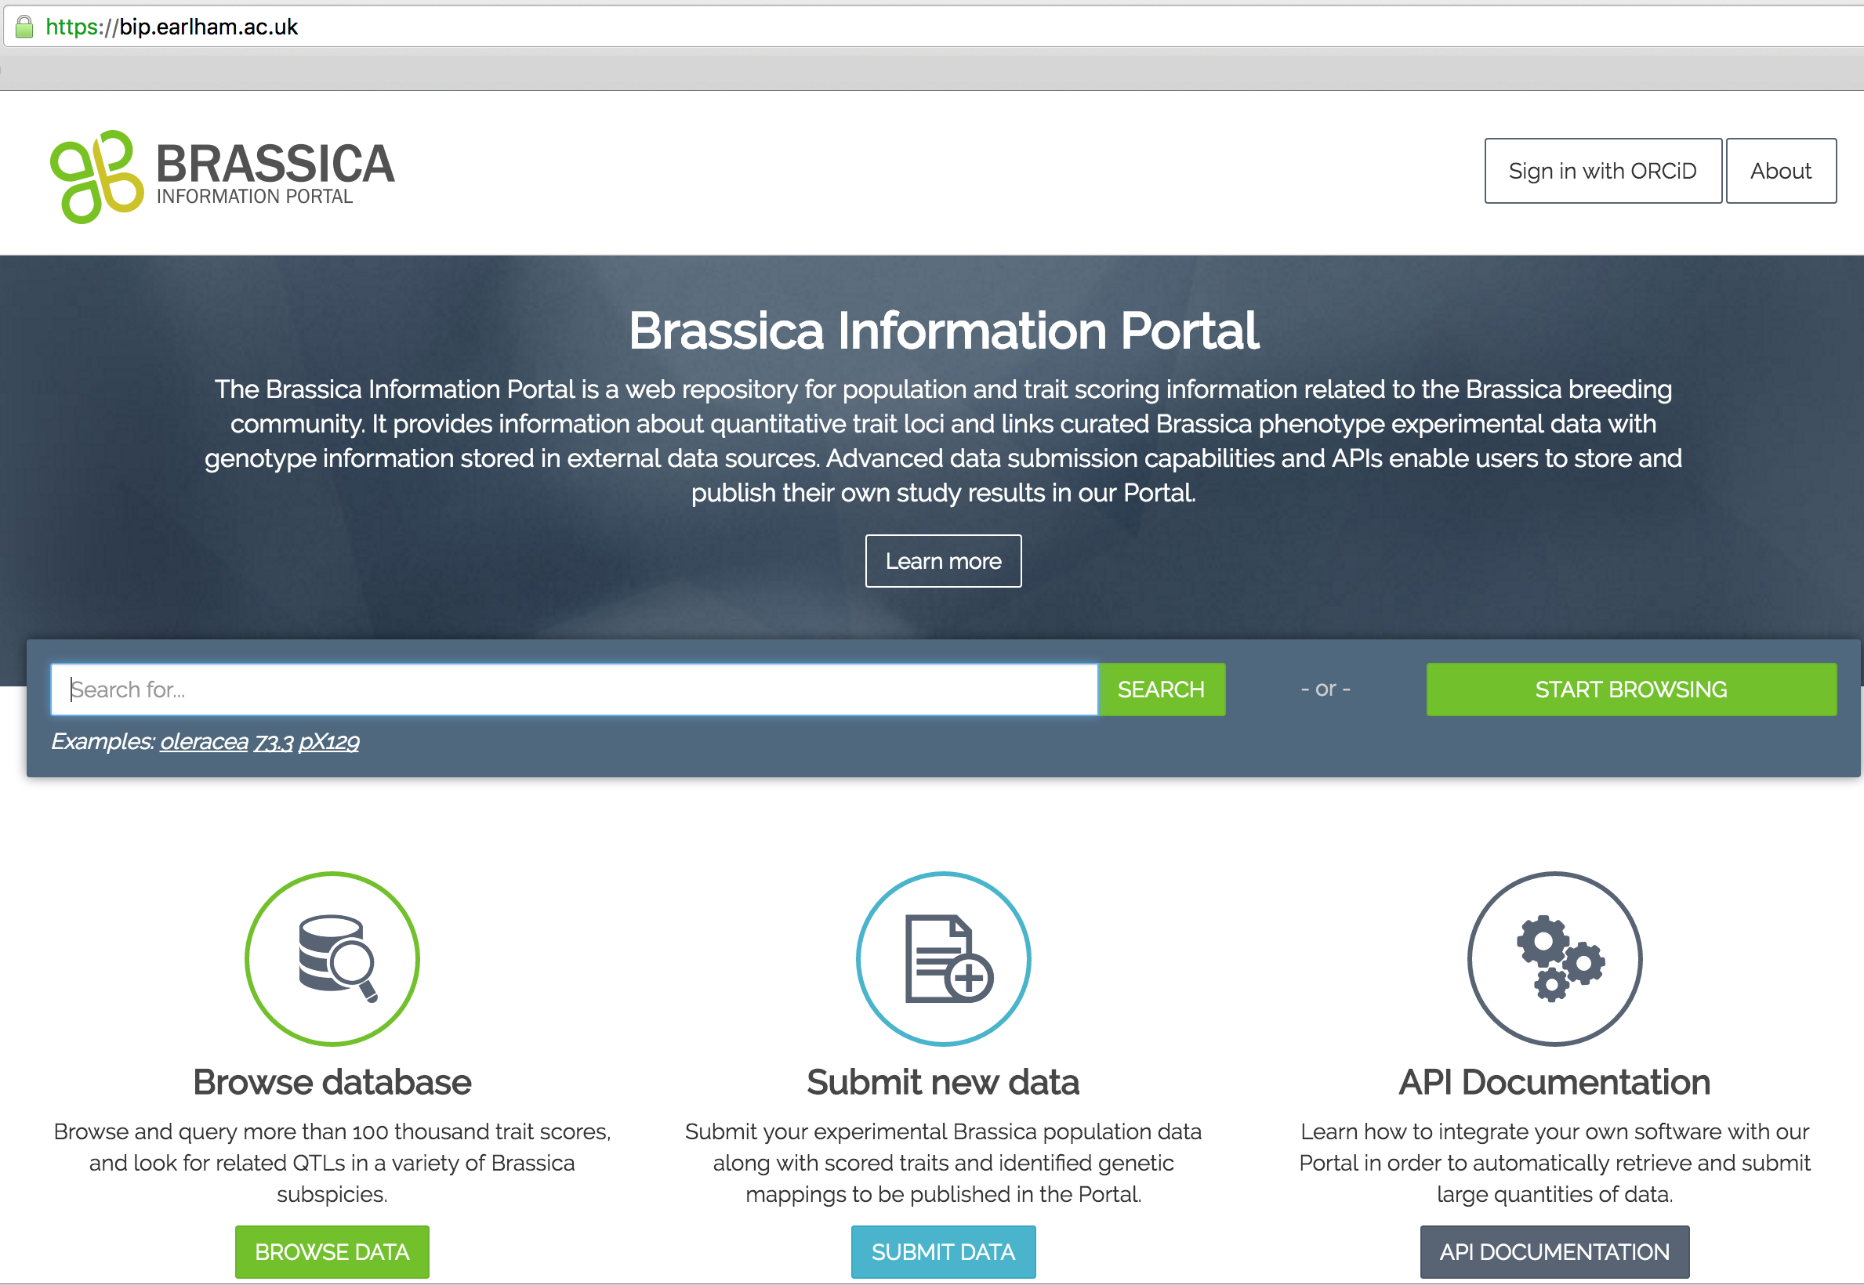
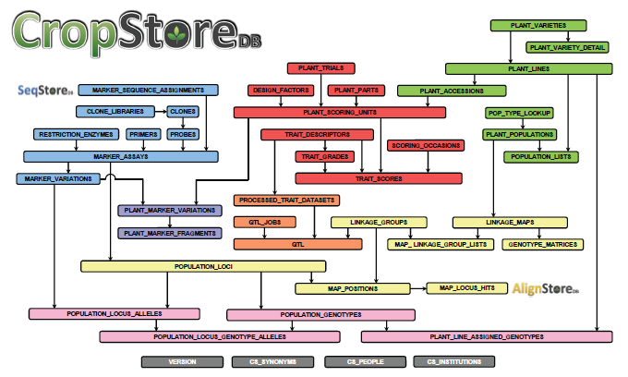
Brassica Information Portal
Ruby on Rails framework
PostgreSQL schema based on CropStoreDB
Tomasz Gubała
Graham King, Piotr Nowakowski

Slide 4
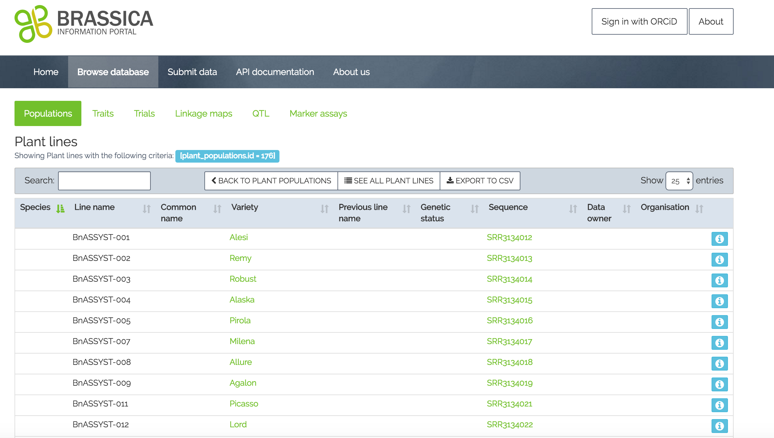
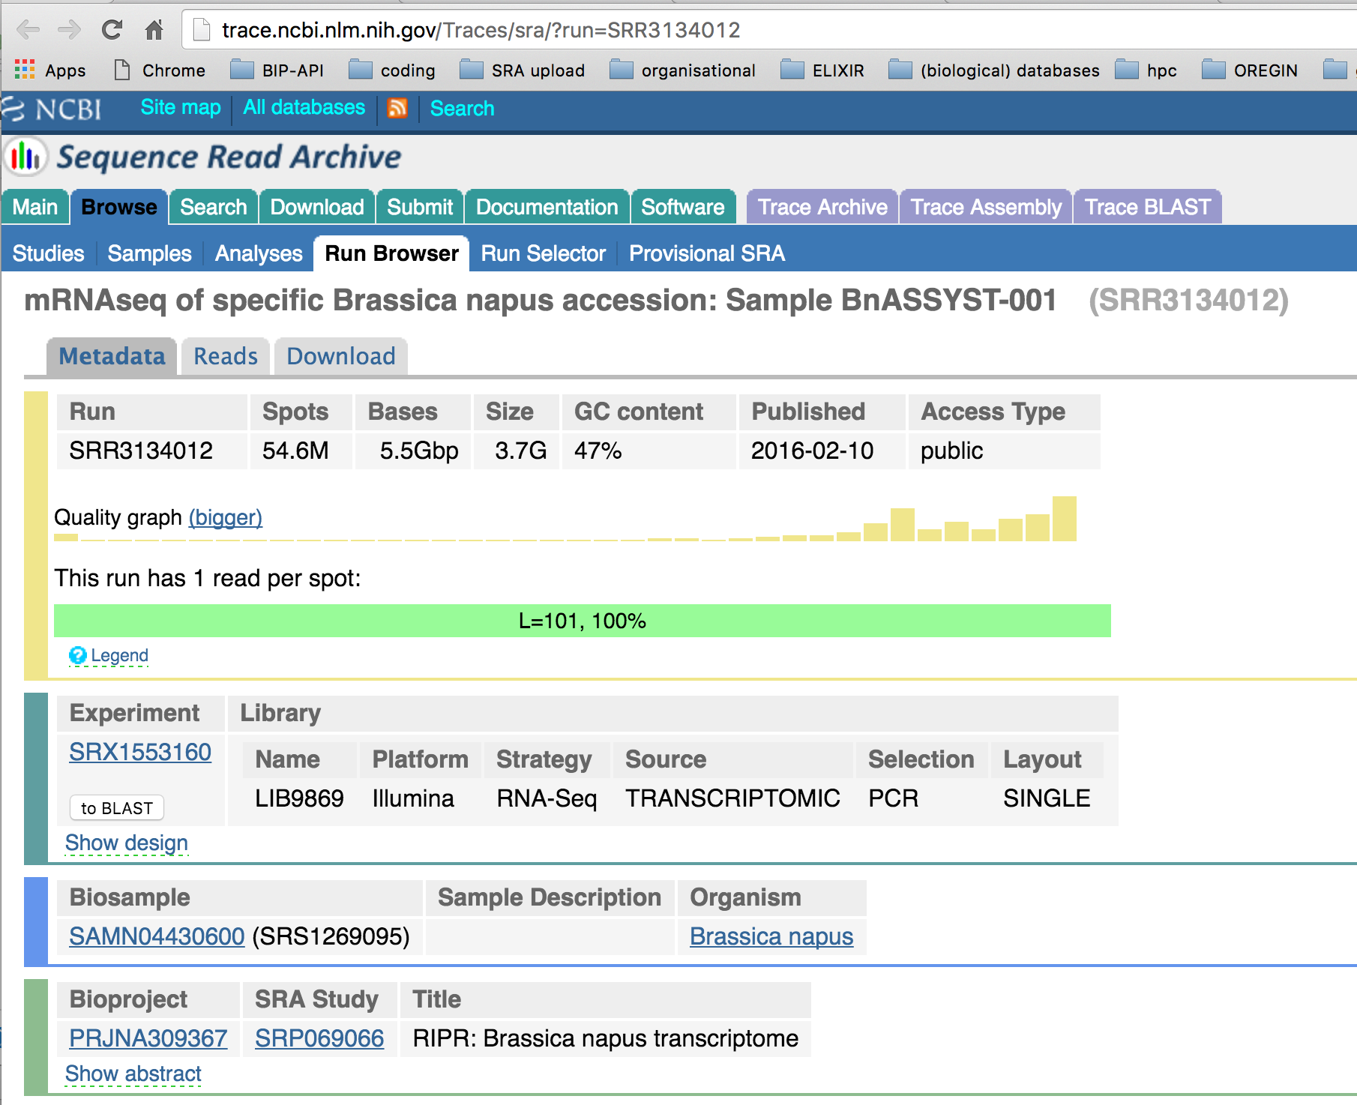
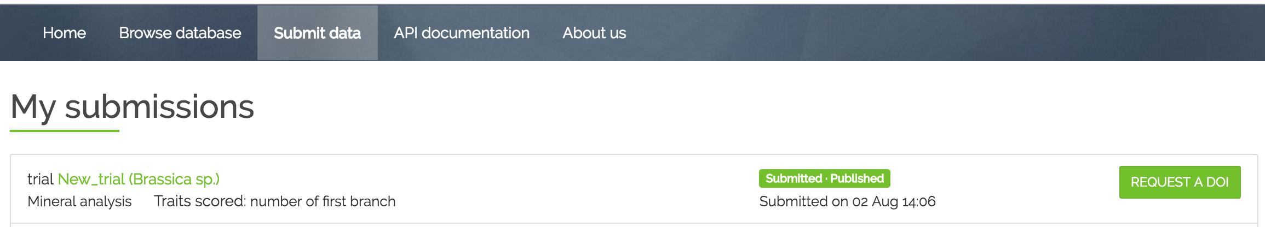
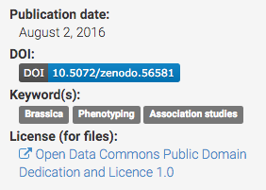
BIP features
Efficient ways to interact with the data: elasticsearch, API
Data cross-linked with sequences
Links to raw imaging data stored at CyVerse
DOI assigned to data set user selected data set
Private/public

Slide 5

BIP and ontologies
Annemarie Eckes
Ontologies currently used in BIP
Taxonomy Ontology (GR_tax)
Plant Ontology (PO)
Crop Ontology (CO)
Internal nomenclature for populations, trials, accessions and plant scoring units
ELIXIR Excelerate: https://www.elixir-europe.org/excelerate/plants
WP7 Integrating Genomic and Phenotypic Data for Crop and Forrest Plants
MIAPPE (Minimum Information About a Plant Phenotyping Experiment)
Notes:
BIP and ontologies + minimal standards
We manage to include Brassicas in Elixir
Part of discussions on data models and minimal requirements for experimental metadata

Slide 6
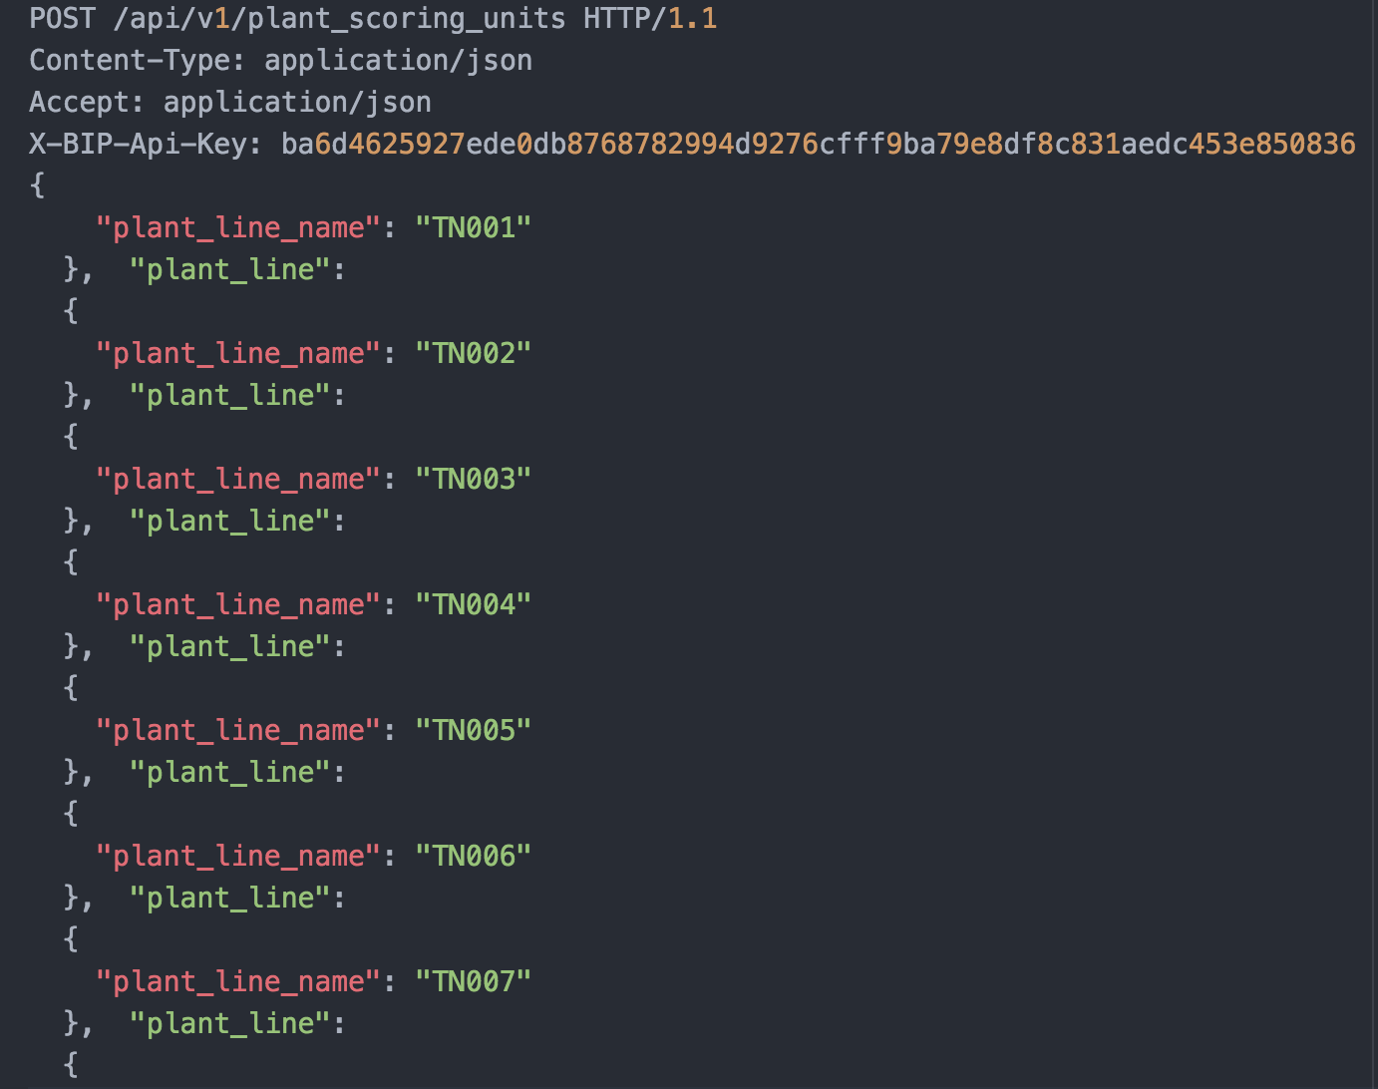
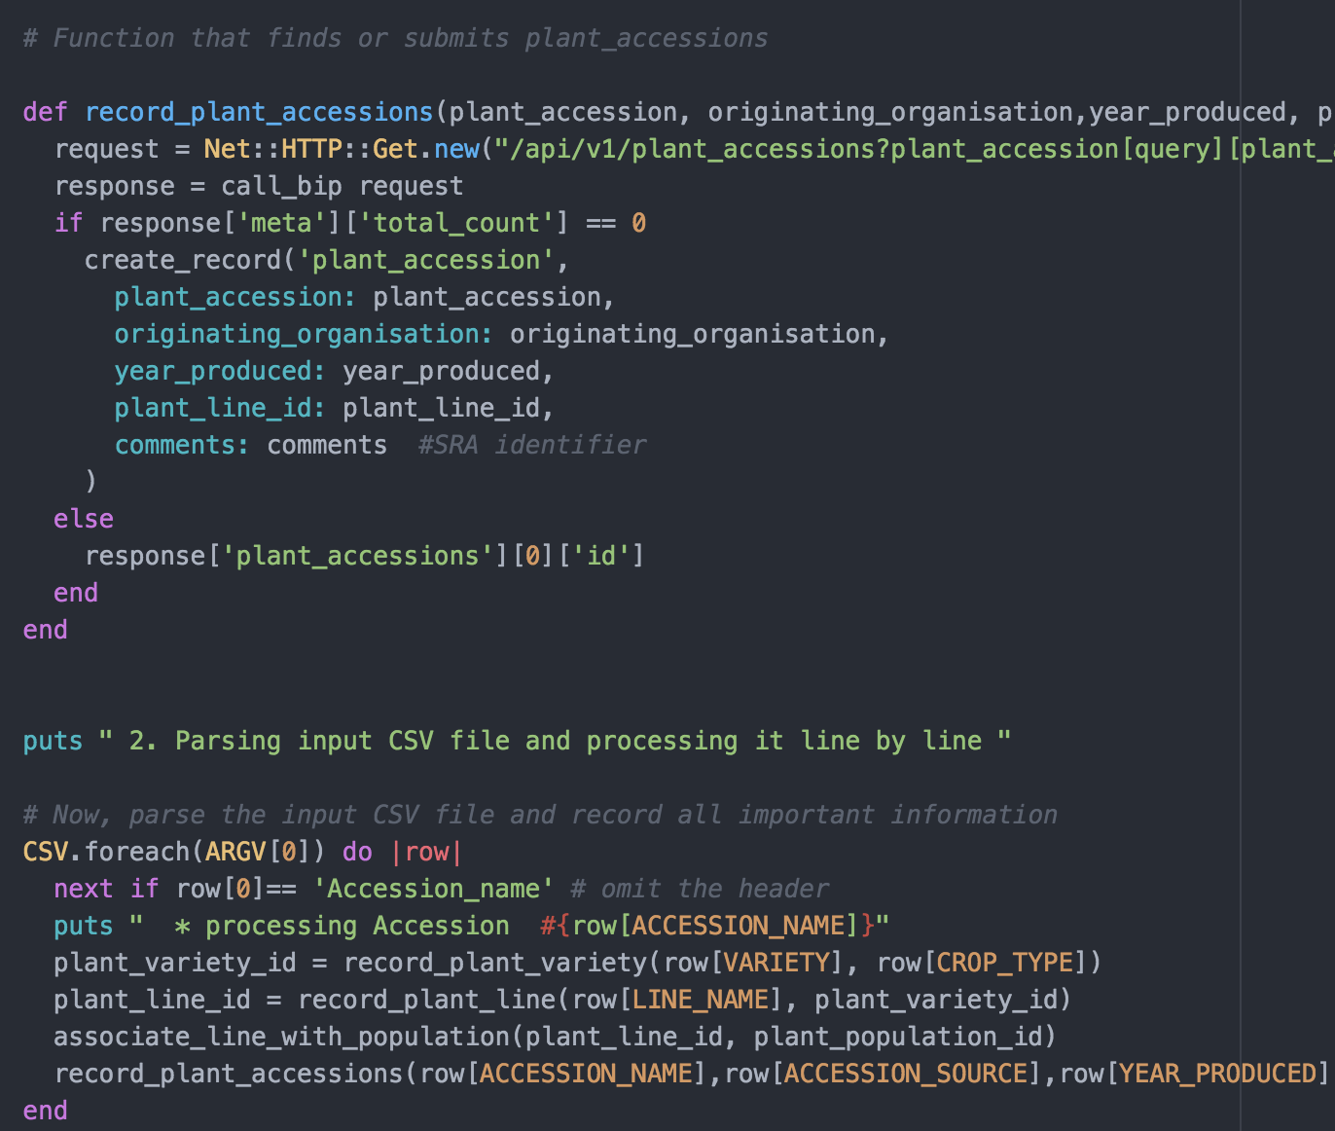
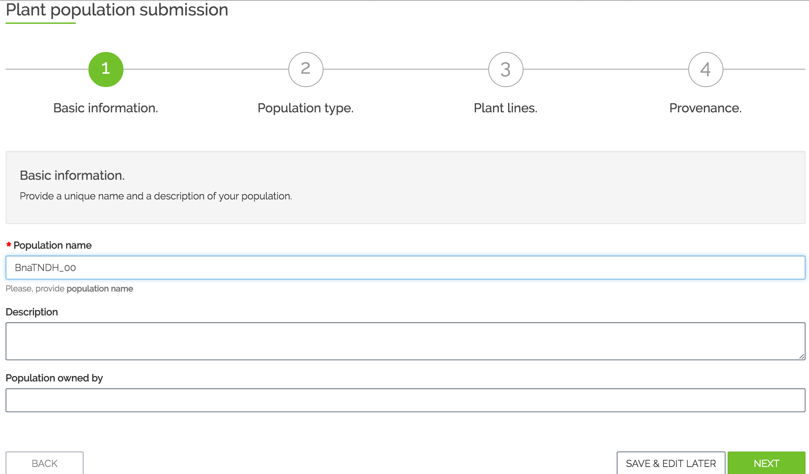
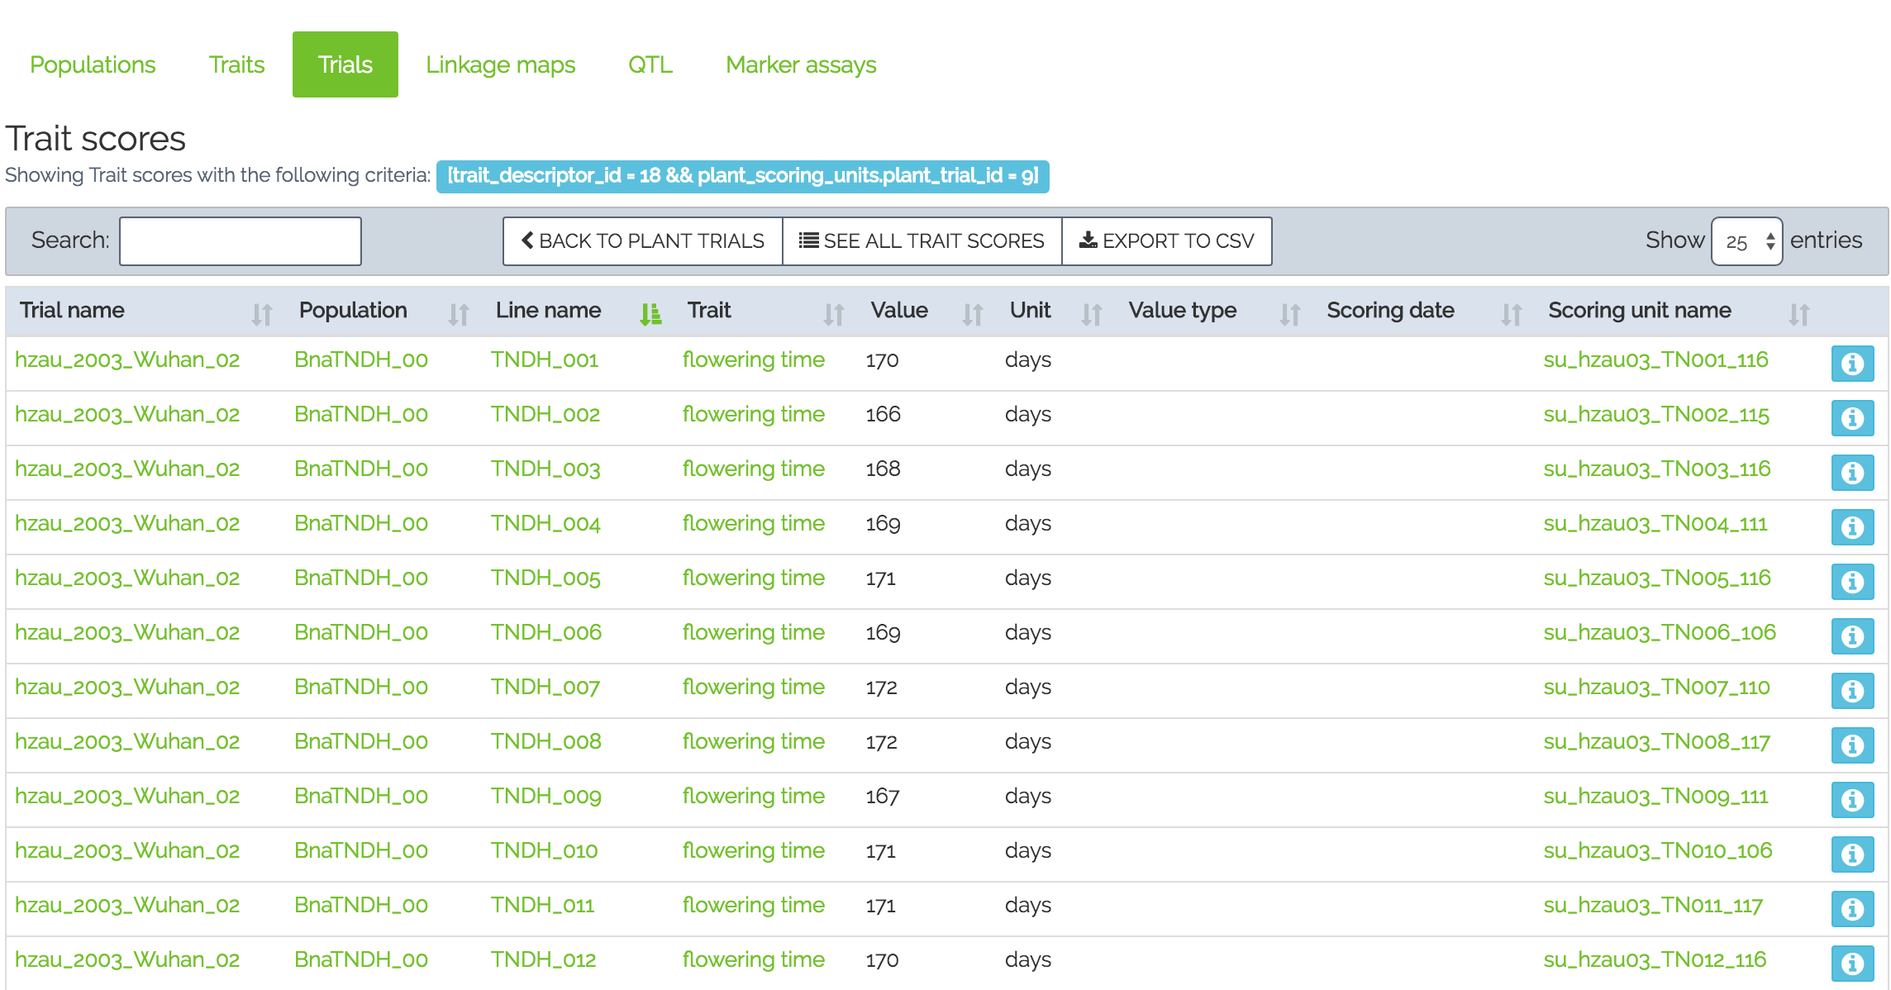
Different ways to communicate with the BIP
Programmatic submission – Population Submission
API layer
Web layer
Wizard based – Trial Submission
HTTPS
Notes:
in the Population submission, we will interact programmatically ,and in the Trial submission, we will interact with the database using the schema.

Slide 7
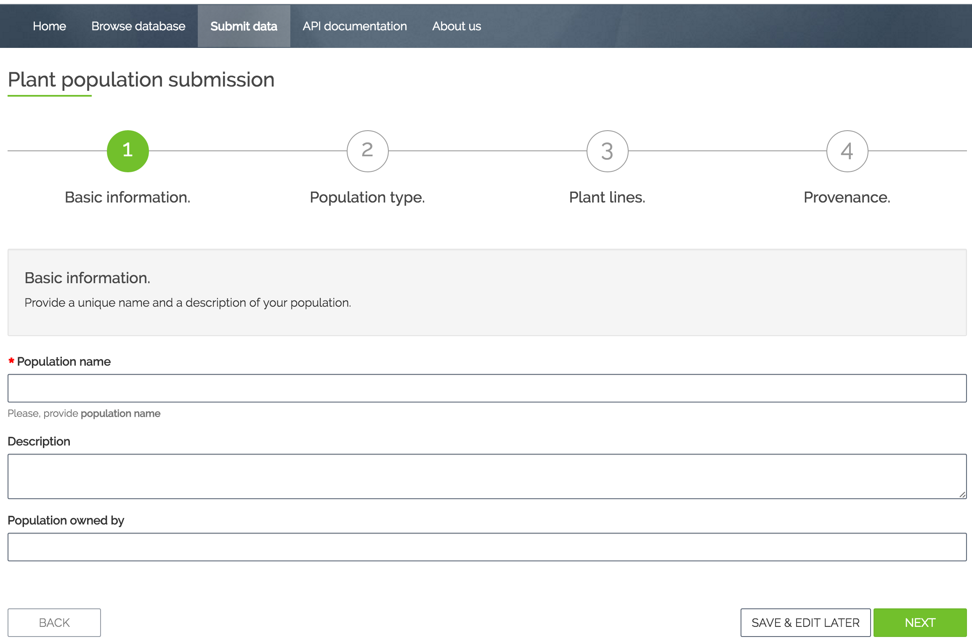
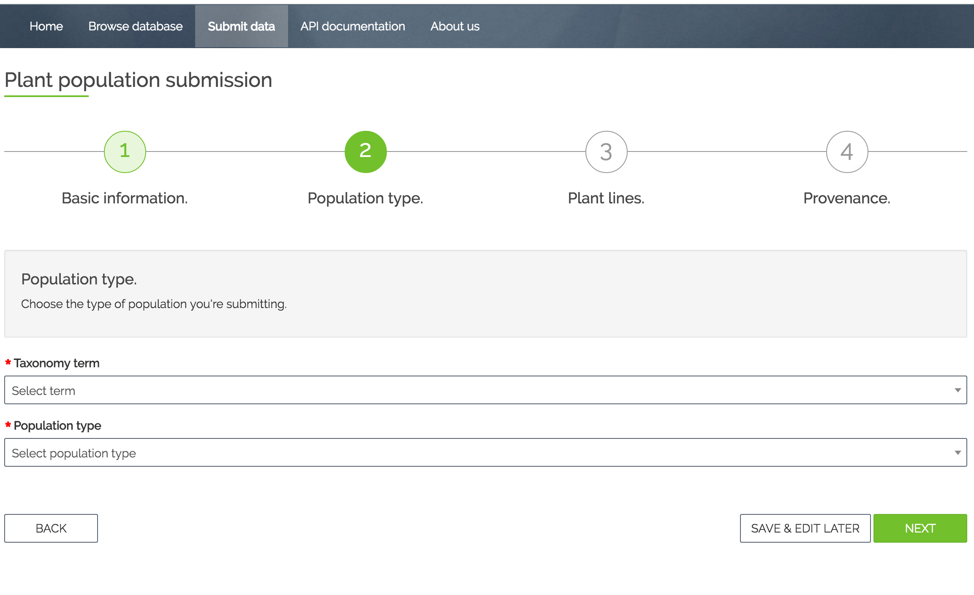
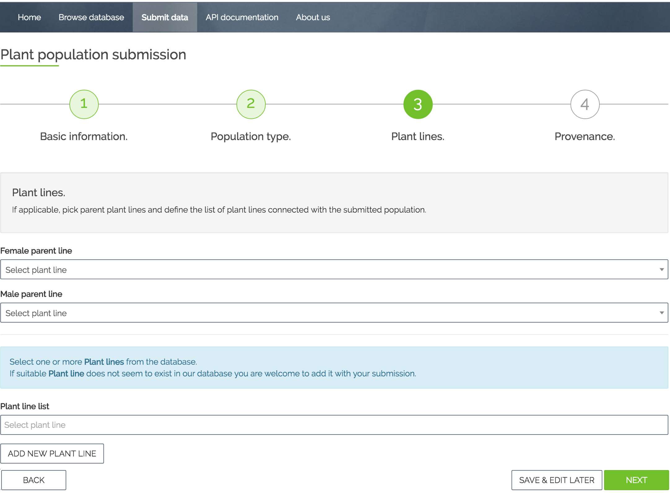
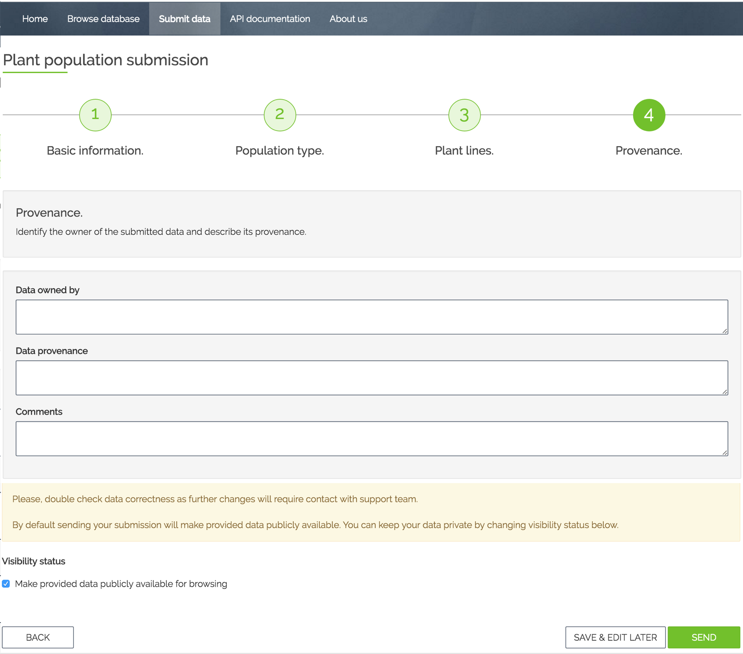
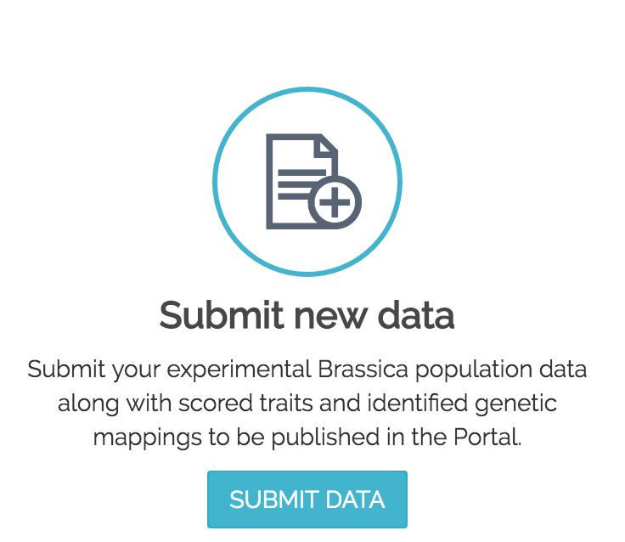
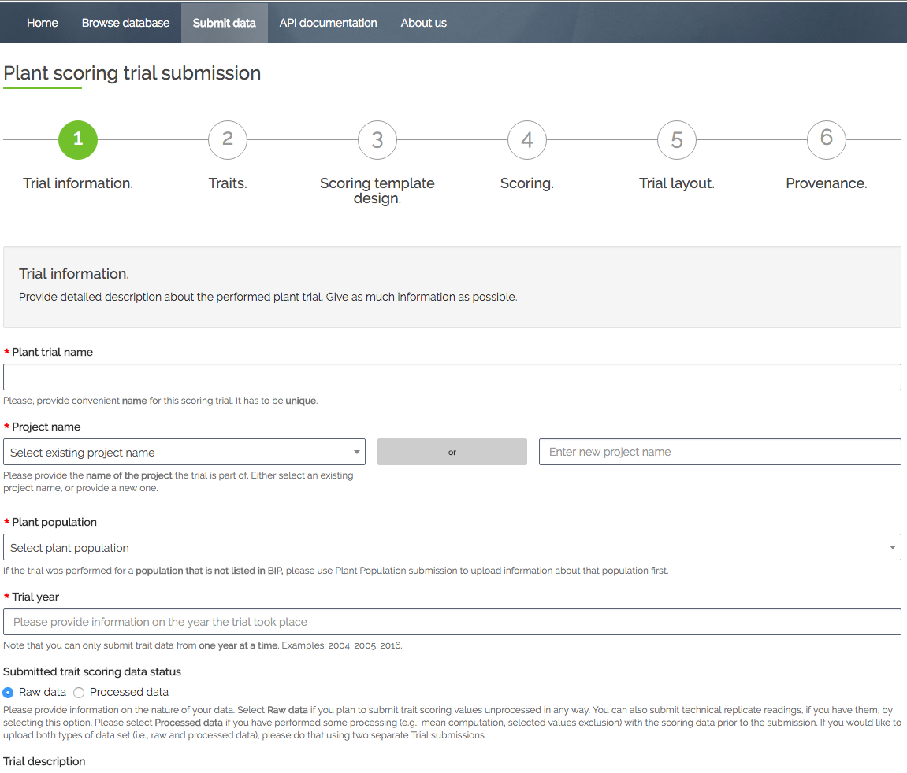
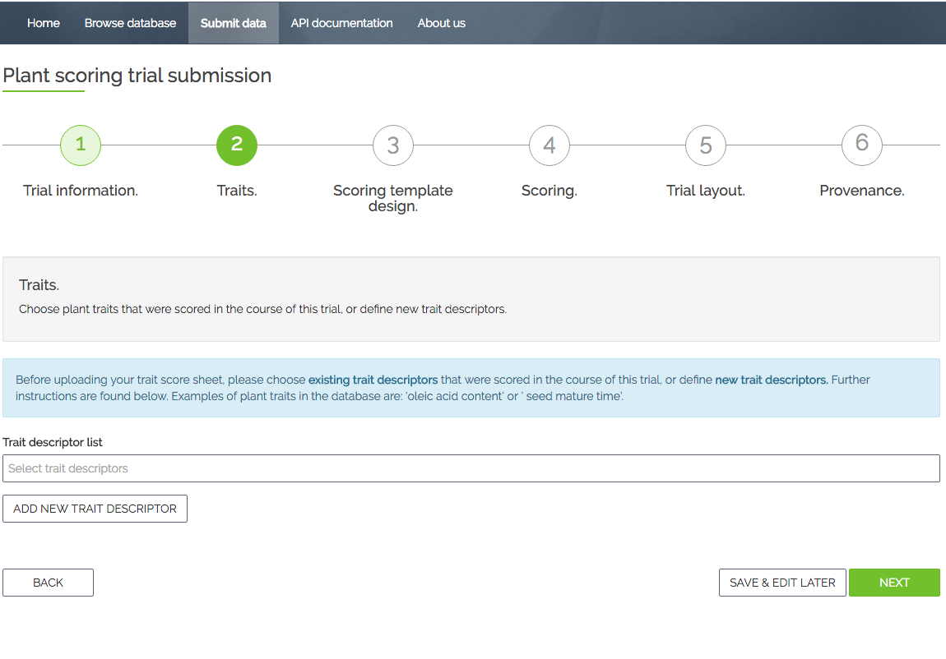
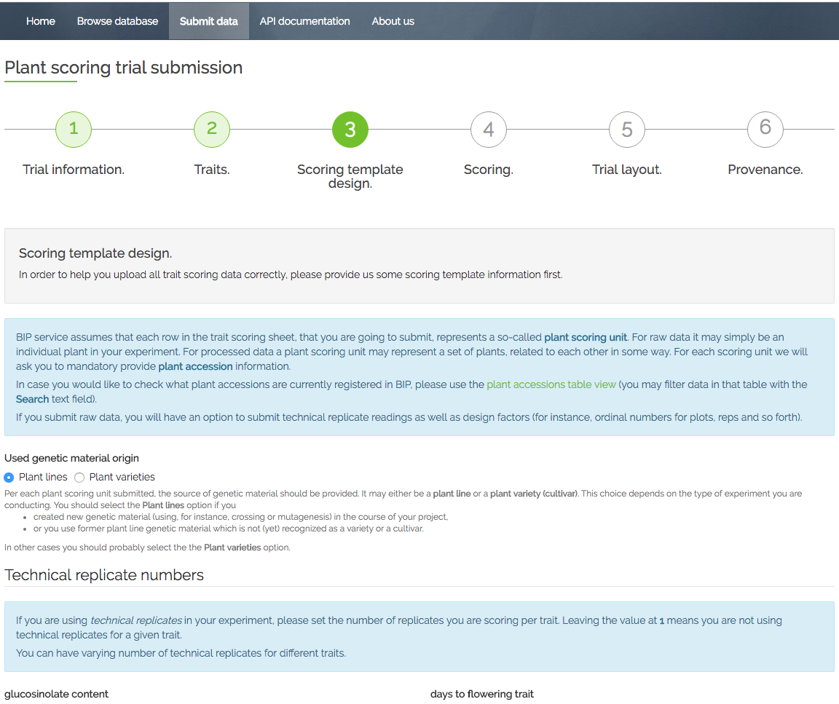
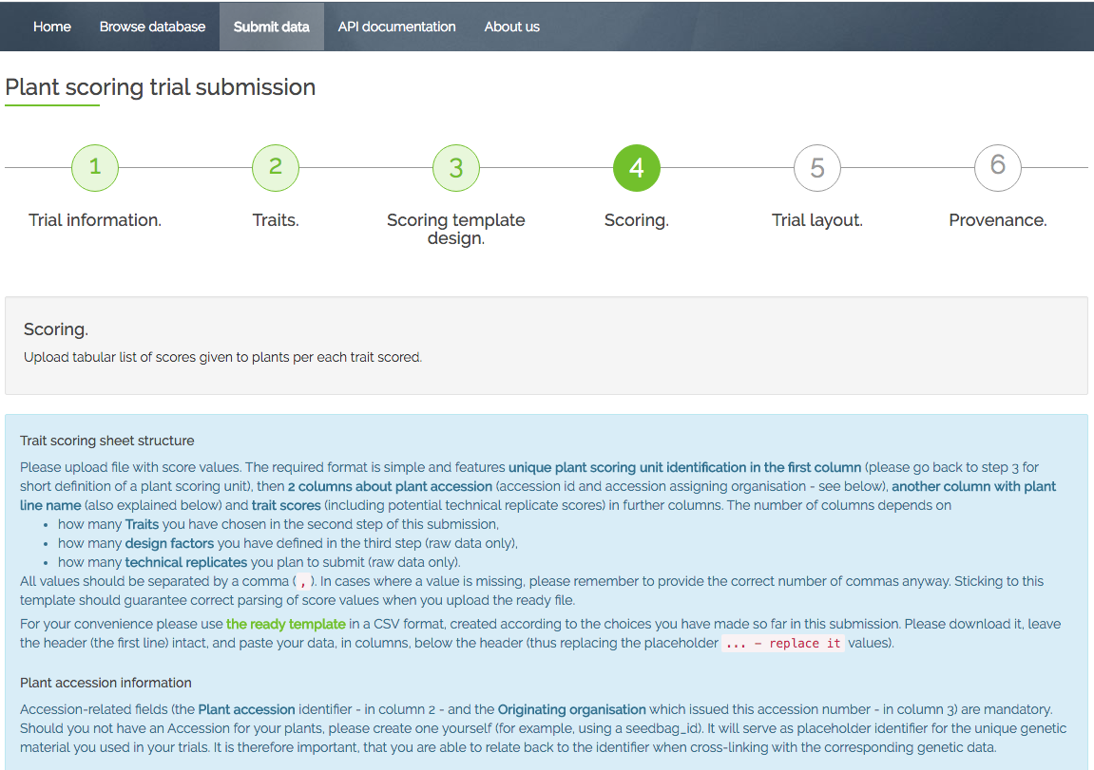
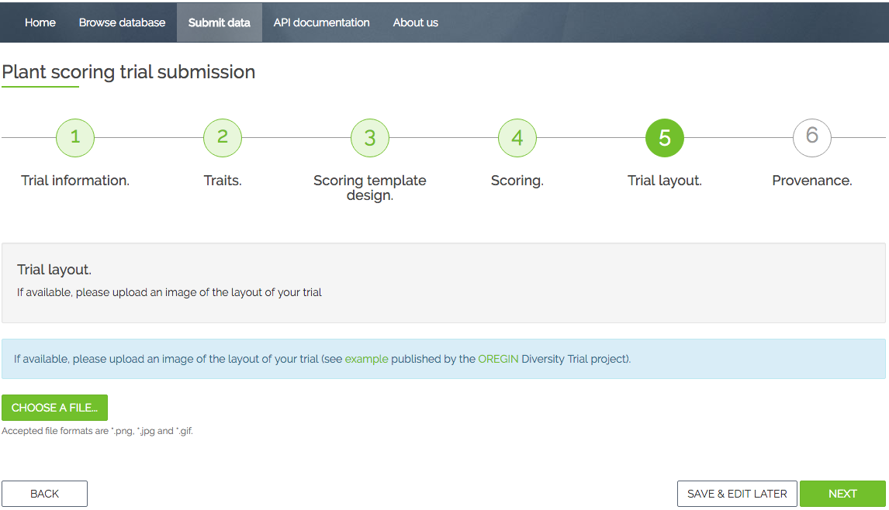
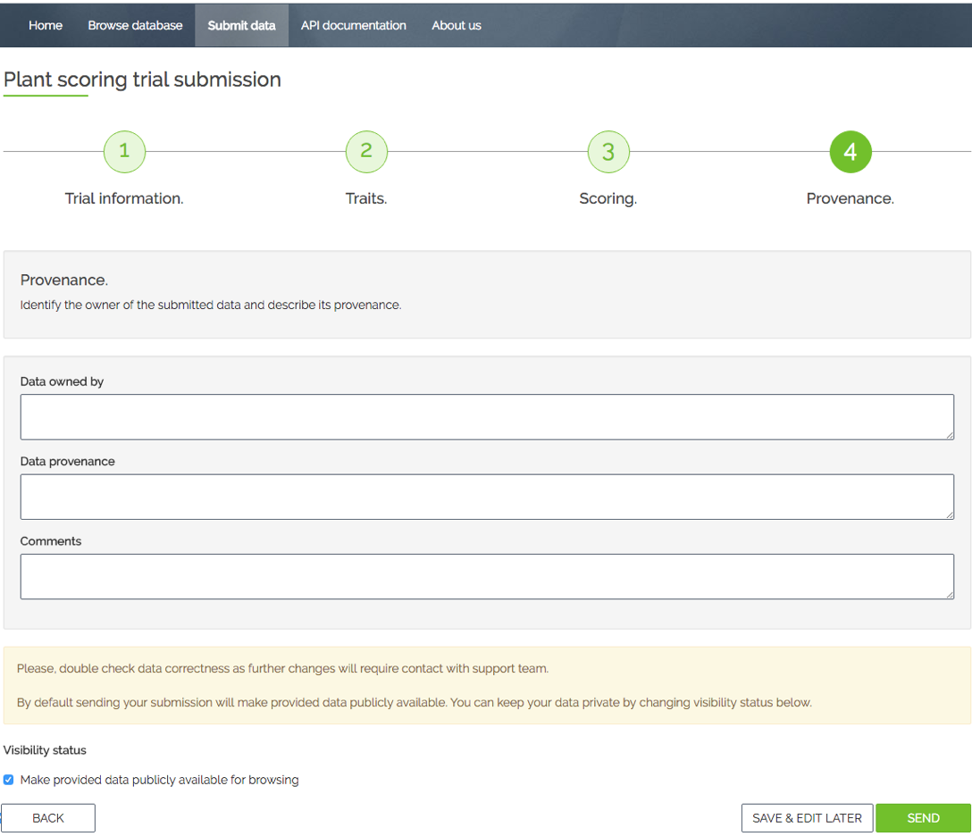
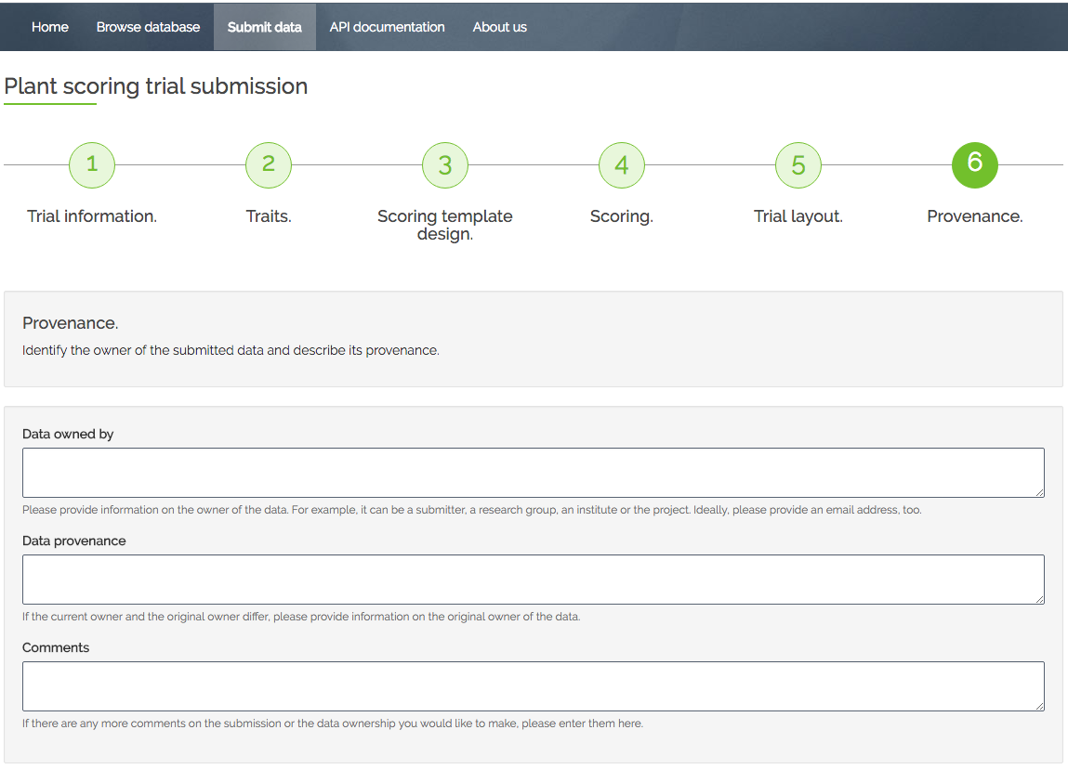
1.
Basic information
2.
Population type, Population Template design
3.
Population Template submission
4.
Provenance
Population Submission
Trait Scoring Submission
6.
Provenance
1.
Trial Information
2.
Traits
3.
Scoring
Template design
4.
Scoring
Template
submission
5.
Trial Layout

Slide 8
Plant Populations
Search
Plant Lines
Cross-linked with sequence data
Plant Trials
Data Submission
Display table or download full package
Wizard or command line
Traits
Lookup trait and method description

Slide 9
DEMO

Slide 10


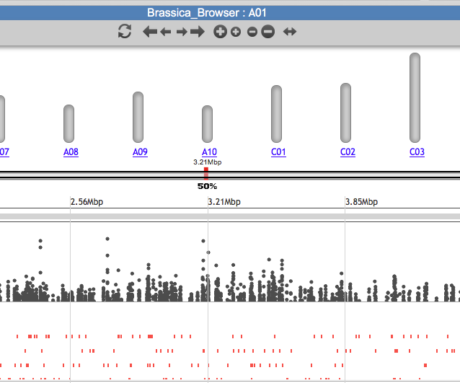

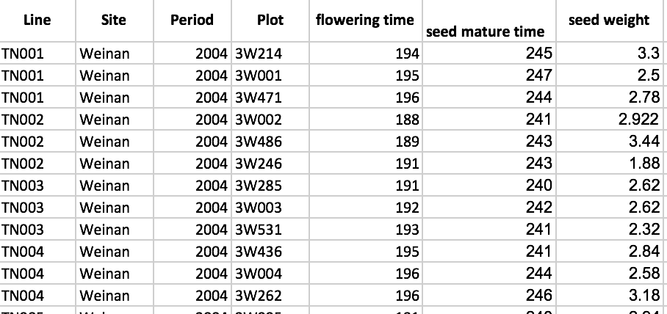
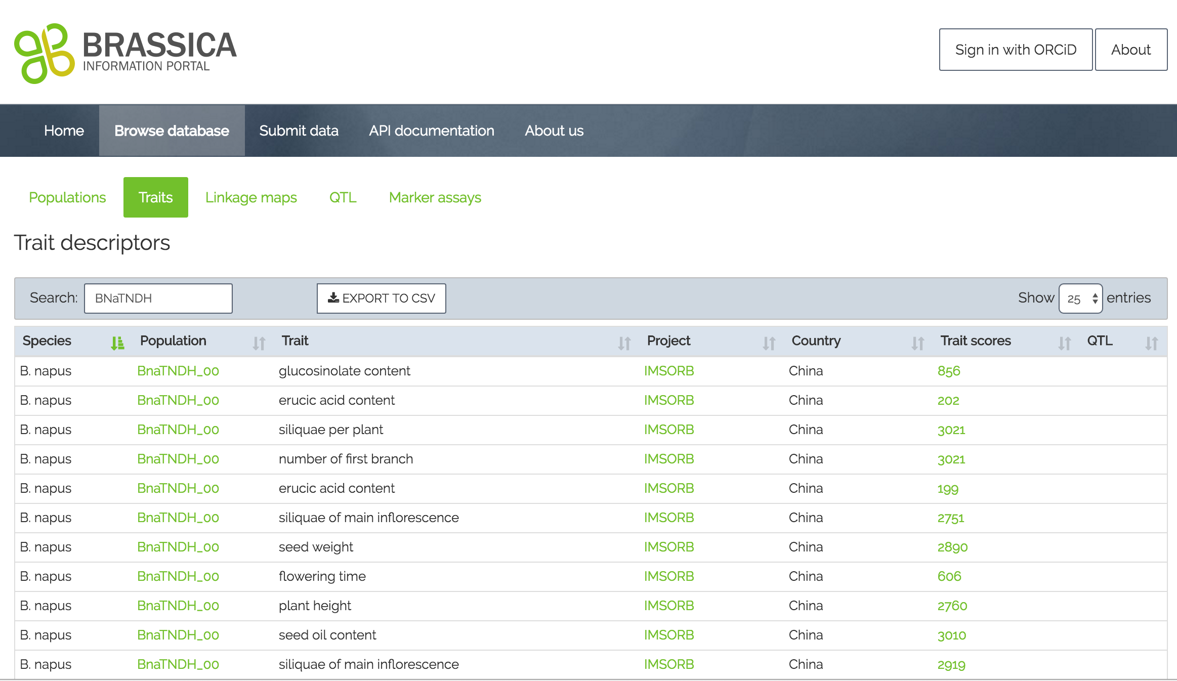

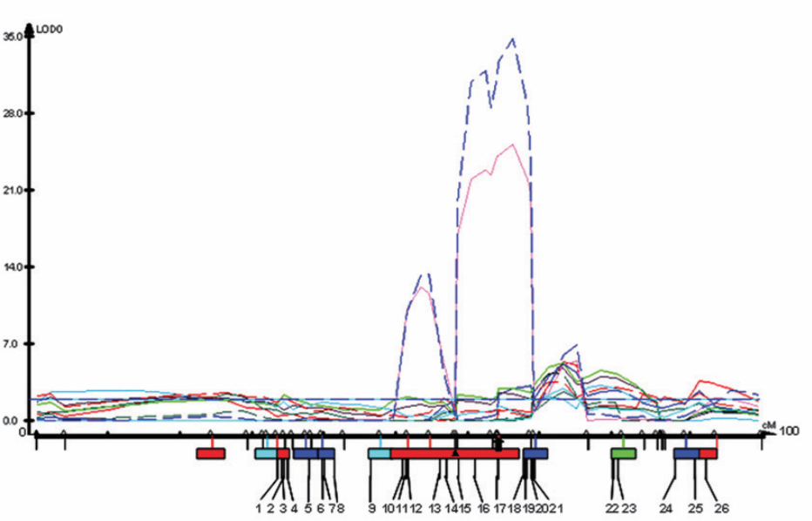
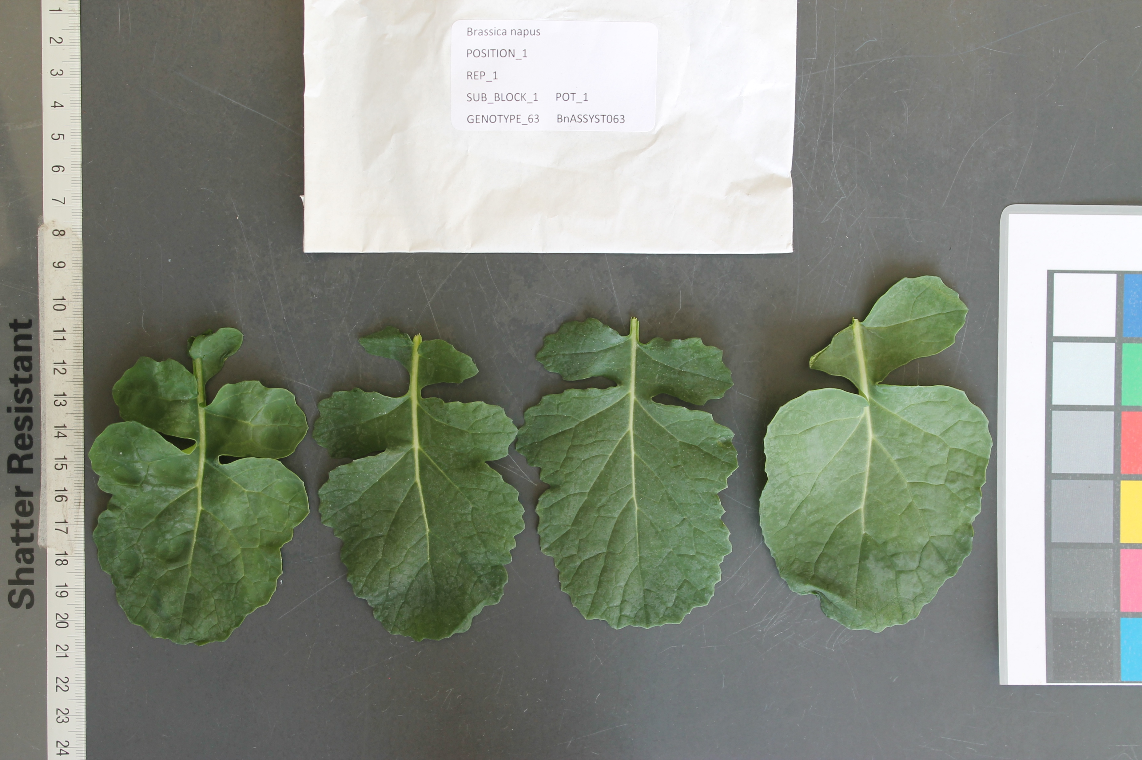


BIP integration with other resources
Extended submission, cross-linking, analysis, publishing
Notes:
BIP integration with other resources
Ensembl Plants
CyVerse UK – workflows
Galaxy
Aim to have resource interconnected with all other resources- use as “hub” for all other analysis.
The original “direction”/way of Using the BIP is linear: Data can be stored and accessed for downstream analysis. It is simply a “repository” of trait scoring data for Brassica crops.
But we are working on extending and cross-linking its functions, some of which I will present later. For example, we have made it possible to submit image names and draw from CyVerse as a default resource to cross-link the image names submitted to BIP.
Extension: make user submit image data alongside with measurements. The images will automatically be stored in CyVerse as opposed to the user having to do this manually.
The user can now submit sequence identifiers from SRA with the submission, which are automatically cross-linked with the corresponding entry in NCBI.
It is now possible to access the BIP via the TGAC browser. The feature allowing this is dependent on background data uploaded to the Browser by the administrator.
In the background of the brower, SNP information for the RIPR population is loaded. People interested can select lines carrying certain SNPs of interest and compare them with lines not carrying these SNPs. During this analysis, the user can look up the line in the Brassica Information Portal and see any related information about the line there ( e.g. registered trait measurements, origin, Cultivar name, all experiments using that line, etc.., )
-Note that this feature is currently only accessible as a service for the RIPR project, as it is sensitive data.
Legacy data sequences- where possible are cross-linked with Ensembl/ NCBI.
We are working with the CyVerse team to integrate their analytics tools with the BIP.
Latest developments were to obtain DOIs for datasets submitted to BIP.

Slide 11

The Brassica Information Portal in the Research Cycle
Identify pot. collaborators
Meta analysis of data content
Research question
Finding communication
Study design
Get inspired by existing studies
Perform associative analysis with cross-linked genotypic information
Define and submit the traits
( new Ontology terms)
Data analysis
Data collection
Data submission
Perform on-the-fly statistical analysis of raw data and compare with existing studies
Have metadata and trait data ready
Notes:
All possible interactions the Brassica Information Portal can have with the Research Cycle in plant breeding research.
The Portal can be integrated in all aspects of Brassica research from generating a research question and collaborations from selecting or defining new traits to measure, through data handling and storage to associative analysis.
Also a summary slide for what I have done and future developments.
Don’t forget to CLICK ( rearrange and add points?)
Learn how to submit external traits
Spreadsheet templates for data collection, easy straight forward
findings –gateway to publish your data
Change order of slides ?

Slide 12






Graham King
Baten Abdul
Ian Bancroft
Lenka Havlickowa
Zhesi He
Ian Wood
RIPR
Annemarie Eckes
Tomasz Gubała
Piotr Nowakowski
Tomek Szymczyszyn
Bartosz Chucherko
Rachel Wells Judith Irwin
Elisabeth Arnaud
Sarah Ayling
Tim Stitt
Anil Thanki
Robert Davey
Hanna Ćwiek, TransPlant
Erik Van den Bergh
Ramona Walls
Dan Bolser
Guy Naamati
Notes:
Thank-you slide:
Thank the Collaborators- not Biologists

Slide 13
Features
Feedback
User experience
Bugs
BIP framework can be reused for other crops!
Framework: github.com/brassica
Documentation: bip.earlham.ac.uk
Training materials with use case: github.com/BIP_training

